Slide 1



Global air pollution modelling
University of Utrecht, The Netherlands
Global and geo-health data center
Meng Lu

Slide 2
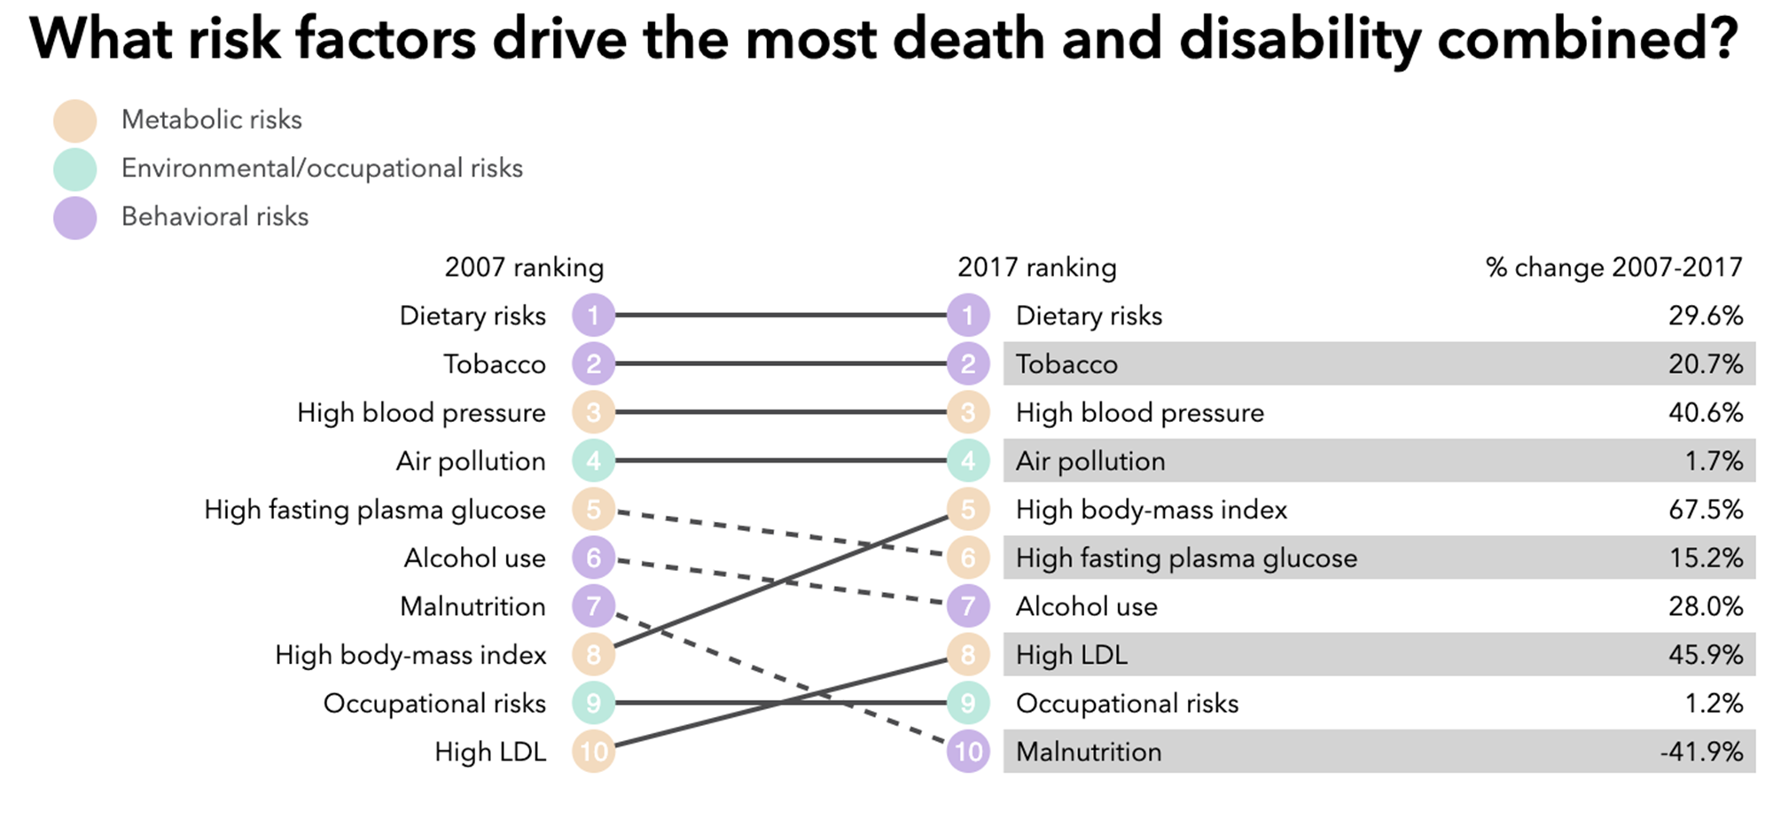
Air pollution -- Consists of chemicals or particles in the atmosphere that poses health and environmental threats.
Mortality:
World: more than 3.2 8.8 millions death a year estimated by WHO

Slide 3

Goal: Global, high spatial and temporal resolution NO₂ mapping NO₂: is part of a group of gaseous air pollutants produced as a result of road traffic and other fossil fuel combustion processes.

Slide 4
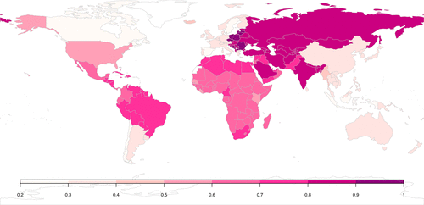
Why global?
Estimation of global burden of disease
to monitor the UN established Sustainable Development Goals
Consistent epidemiological studies world-wide
Inequality in health and air pollution monitors in middle and low income countries
Shaddock et al., 2018

Slide 5

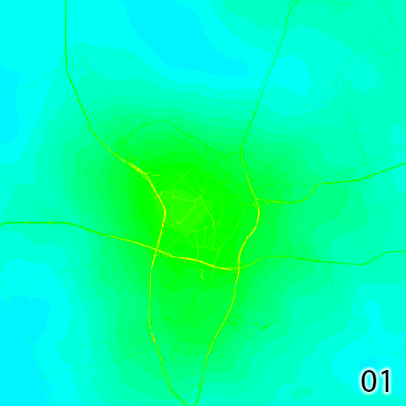
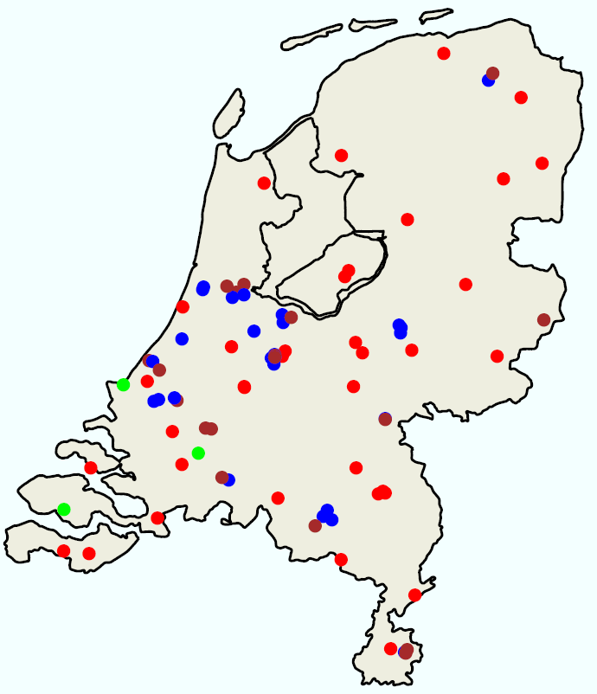
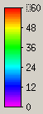

Why high spatial and temporal resolutions?
60
30
RURAL
TRAFFIC
INDUSTRY
Hourly/minutes
LML data (landelijk meetnet luchtkwaliteit)
0
Hour
0
5km

Slide 6

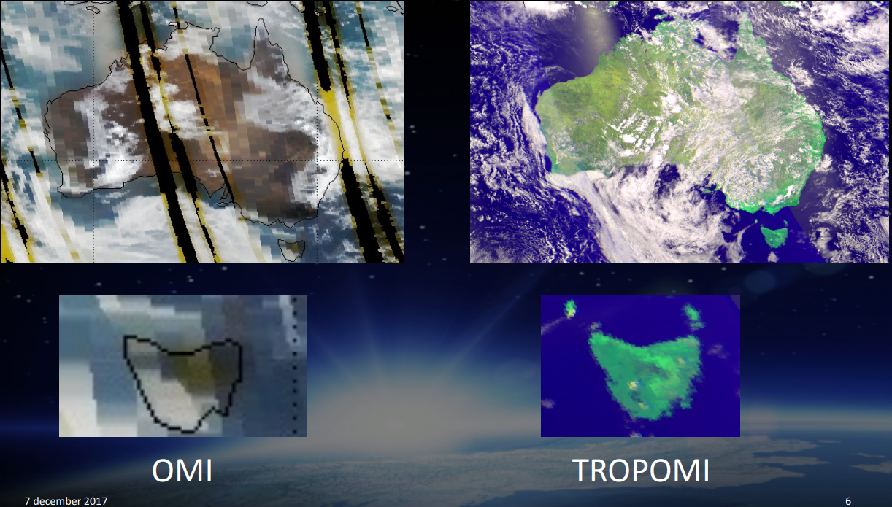
Tropomi
(TROPOspheric Monitoring Instrument)
Launched Oct. 2017,
Resolution
2018-2019: 7.5 km
Since Oct. 2019: 5.5 km
NO₂, O₃ (7km × 28km), SO₂, methane and CO
Souce [3]

Slide 7
Air pollution modelling methods
Process-based models:
Air dispersion models
Chemical transportation models
Statistical-based methods:
Information form predictors, spatiotemporal dependence.

Slide 8
Questions
How can we …
model the heterogeneities between areas (e.g. city, country)?
integrate data of different sources: measurements from different sensors and predictors with different resolutions?
model the effects of road infrastructures?

Slide 9

Ground monitor measurements:
OpenAQ
Additional data from China, Australia, Canada, US, EU

Slide 10
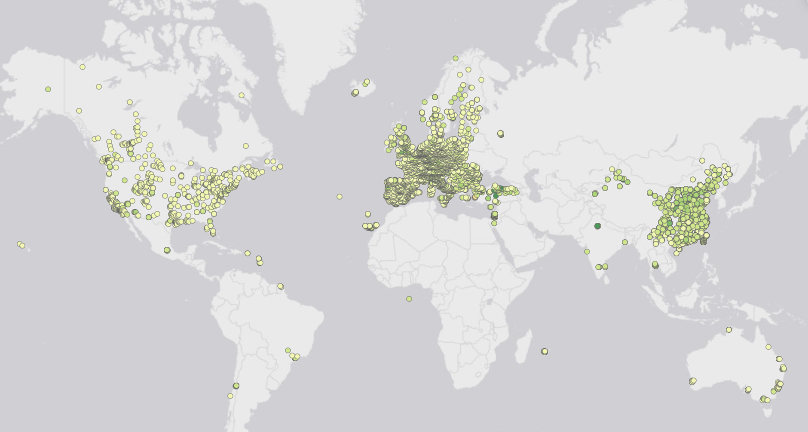

Slide 11
Predictors
Road and industrial area from OpenStreetMap (vector)
Earth nightlight (500 m)
as a proxy for socio-economics
Population (100 m)
From human settlement layers
Climate:Wind speed and temperature
Elevation: SRTM (90 m)

Slide 12
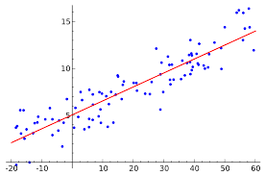



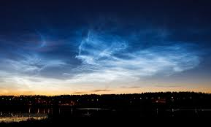
Preliminary Study
Tree-based machine learning methods vs. Linear regression. With and without regularization
Global models Vs. National models
Temporally-resolved: Daytime Vs. Nighttime models

Slide 13
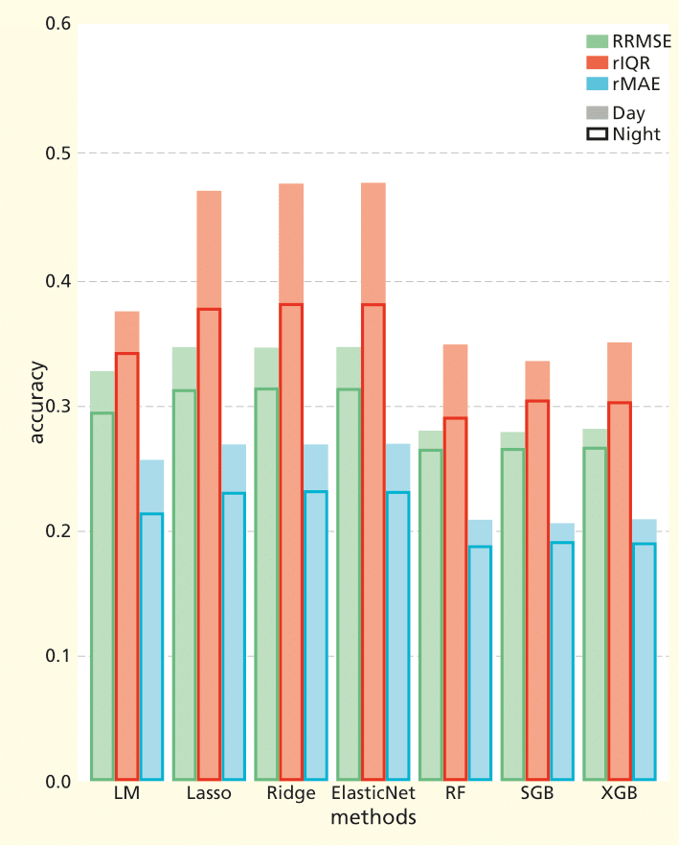
Regression Vs. tree-based methods
RRMSE: relative root mean squared error
rIQR: relative Interquartile range
rMAE: relative mean absolute error
LM: Multiple linear regression
RF: random forest
SGB: Stochastic gradient boosting
XGB: xgboost

Slide 14
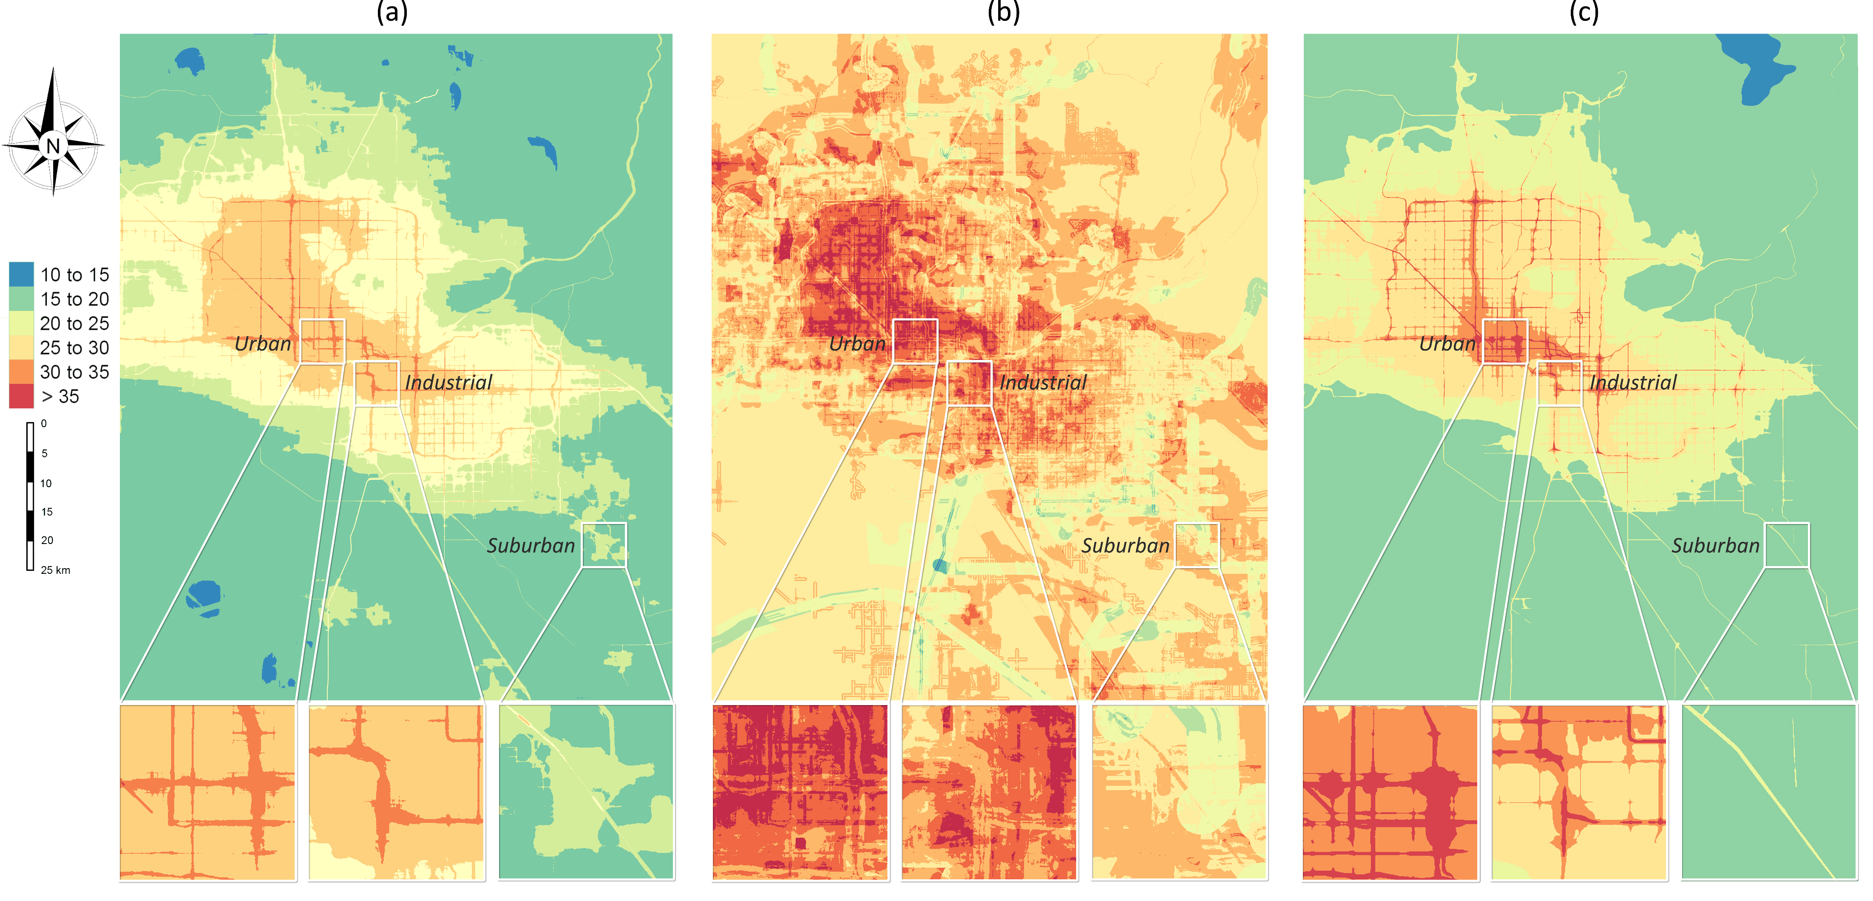
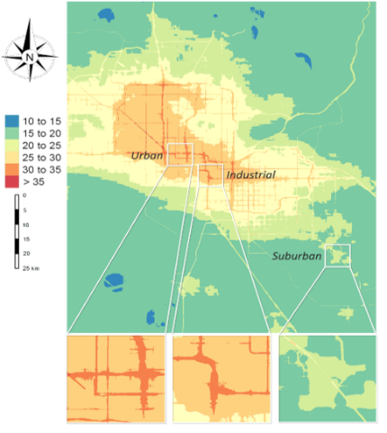


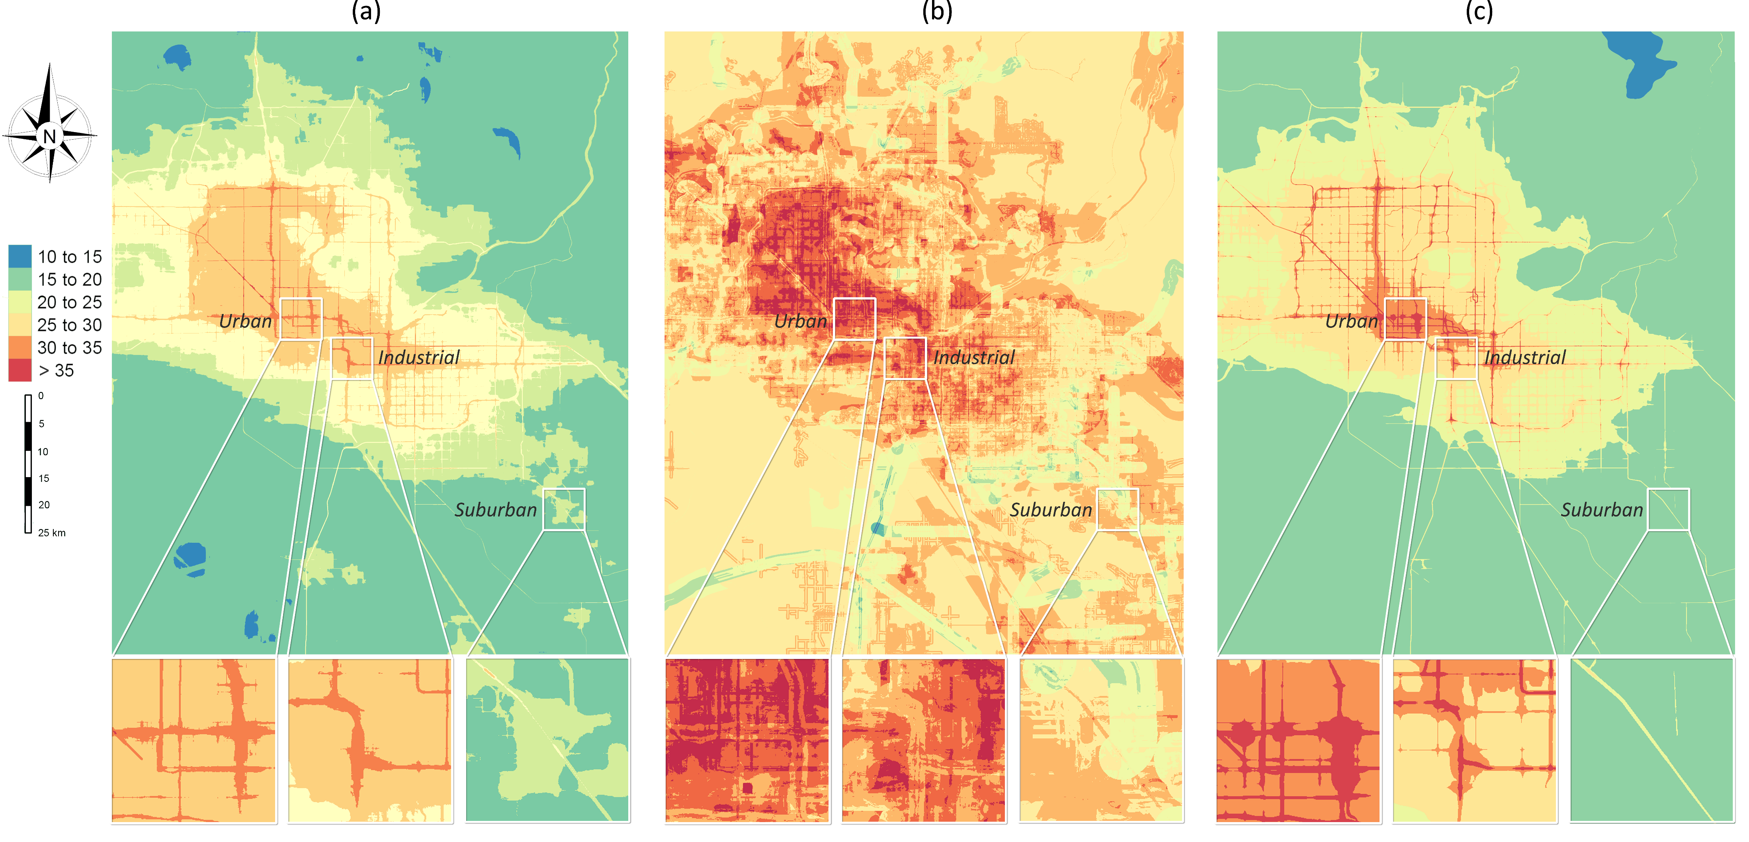

RF
LASSO
NO₂ (µg/$m^{3})$
Phoenix area, Arizona, USA

Slide 15
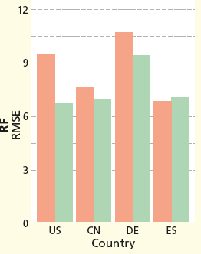
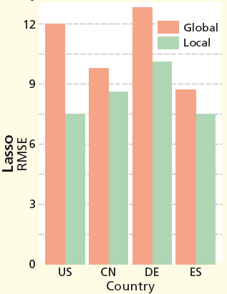
Global Vs. national models
CN: China
DE: Germany
ES: Spain
Conclusion: random forest is more suitable than Lasso for a global NO2 maping and using random forest can achieve an accuracy as good as national models.

Slide 16
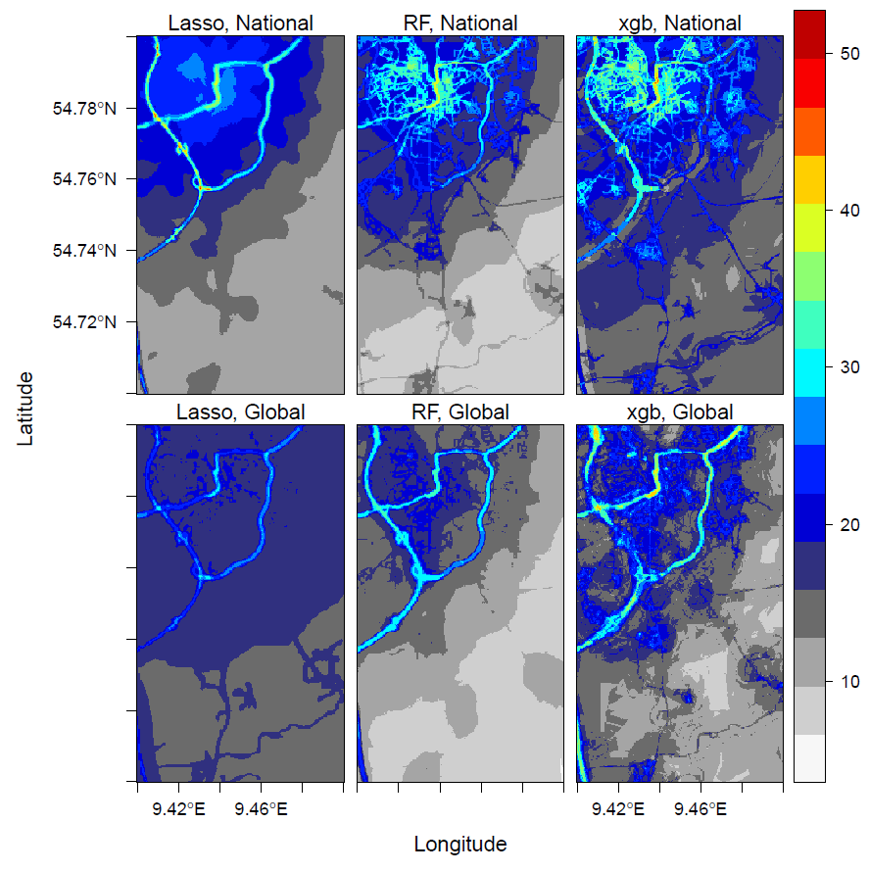
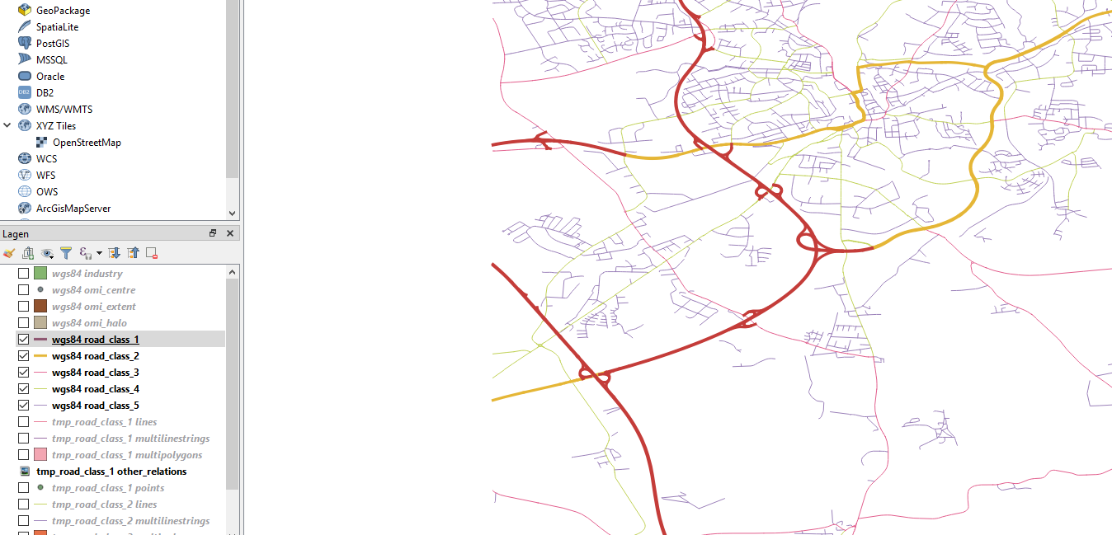
Germany
highway
primary

Slide 17
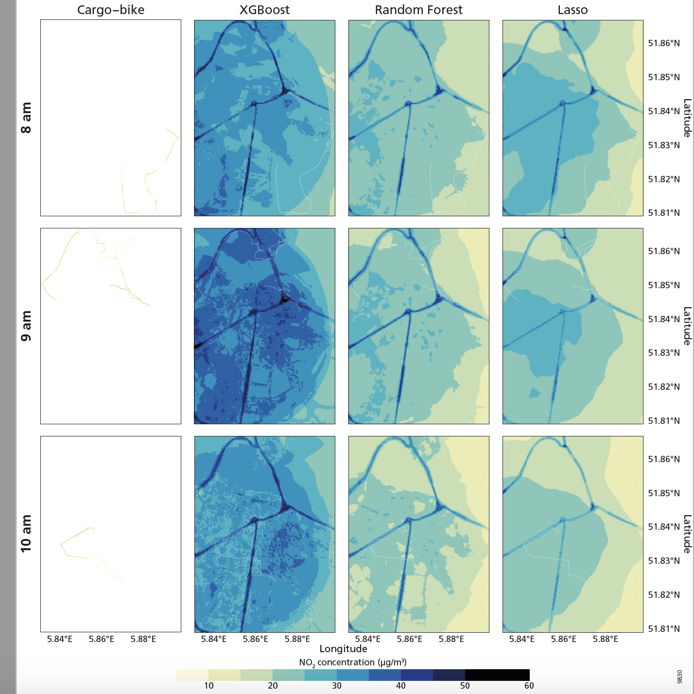
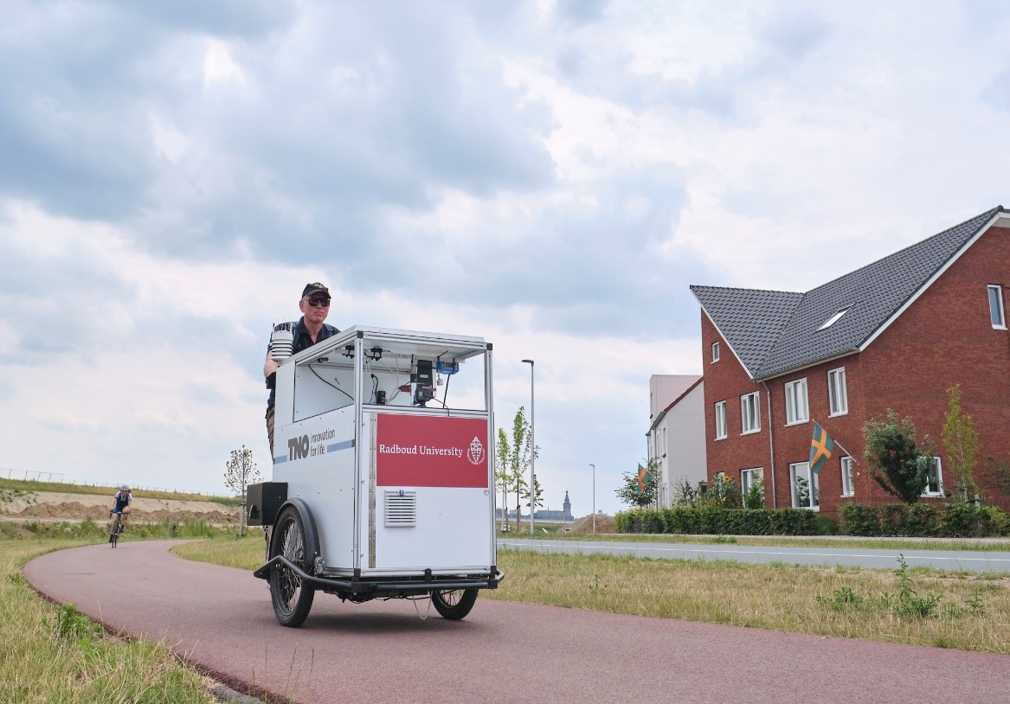
Further validation: cargo-bike measurements

Slide 18
Questions
How can we better…
model the heterogeneities between areas (e.g. city, country)?
integrate data of different sources: measurements from different sensors and predictors with different resolutions?
model the effects of road infrastructures?
A more comprehensive comparison between different methods:
How can we account for spatial patterns when assessing the prediction accuracy?

Slide 19
In the workshop
Intro to air pollution mapping: more details about problems in global prediction
Statistical techniques:
Point-based: Ensemble and boosting trees, SVG, ANN, etc. → Regularization (ElasticNet, XGboost)
Hierarchical: Involving more spatial information and deal with different resolutions:
Mixed-effect models, convolutional NN (computer vision)
Global modeling hands-on: data inspection, wrangling, hyperparameter tunning, validation, mapping.

Slide 20
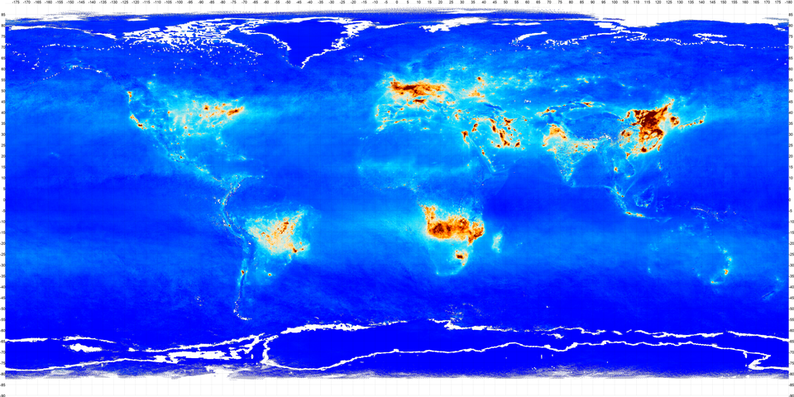
Thank you
Thank you

Slide 21
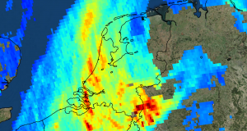
Tropomi
NO₂, O₃ (7km × 28km), SO₂, methane and CO
Electromagnetic field:
ultraviolet and visible (270–500 nm), near-infrared (675–775 nm), shortwave infrared (2305–2385 nm).
zoom in mode: 7 km × 3.5 km
5.5 km x 3.5 km since 2019

